Slide 1
A RECOMMENDER SYSTEM FOR A RESTAURANT
IBM APPLIED DATA SCIENCE PROJECT
BY
NATHAN CLIFFORD

Slide 2
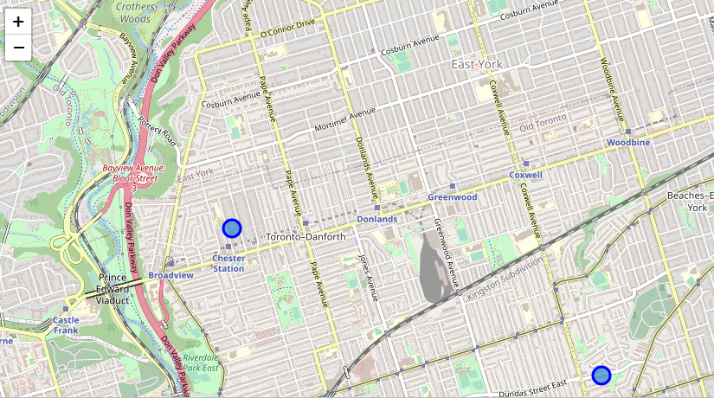
WHICH NEIGHBOURHOOD IS BEST FOR THE RESTAURANT?
EAST TORONTO,
TORONTO CANADA.

Slide 3
Problem Statement
What location is most accessible to customers?
What venue will minimize cost of advertisement to create awareness?
What venues minimizes waste and guarantees survival?
Which location is most efficient to access food raw ingredients?
 | Restaurants | Pizza Spot
Neighborhood A | 82 | 95
Neighborhood B | 76 | 88
Neighborhood C | 84 | 90

Slide 4
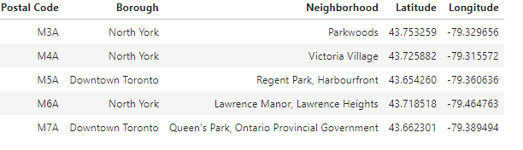
DATA REQUIRED
Geo-locational data of Toronto containing it’s Postal codes, Latitudes and Longit.udes

Slide 5
Retrieving Data from Foursquare
After finding the list of neighborhoods, we then connect to the Foursquare API to gather information about venues inside each and every neighborhood. For each neighborhood, we have chosen the radius to be 1000 meter. It means that we have asked Foursquare to find venues that are at most 1000 meter far from the center of the neighborhood

Slide 6
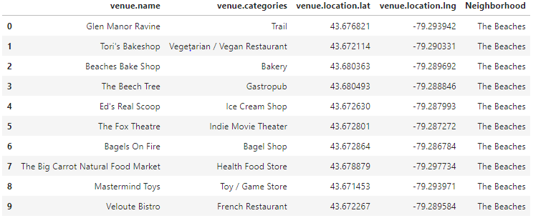
Data is also retrieved from Foursquare
RETRIEVE ALL VENUES WITHIN 1000M FOR ALL NEIGHBORHOODS
Foursquare data for “The Beaches” in East Toronto, Canada

Slide 7
DATA PREPARATION
CONCATENATION
ONE-HOT ENCODING
GROUPING

Slide 8
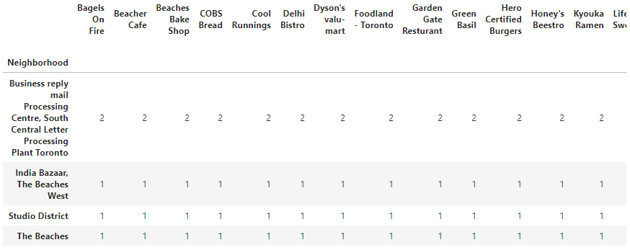
Data Preparation – Final Data

Slide 9
Data is also retrieved from Foursquare
RETRIEVE ALL VENUES WITHIN 1000M FOR ALL NEIGHBORHOODS
Foursquare data for “The Beaches” in East Toronto, Canada

Slide 10
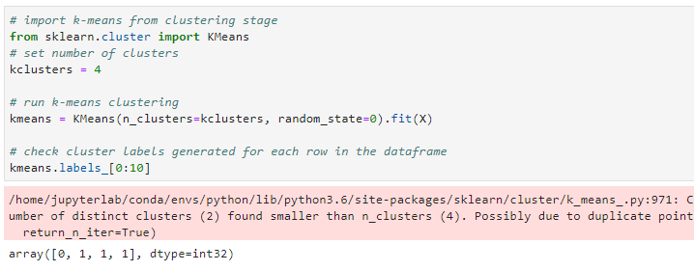
Clustering - KMeans
Kmeans returns only two clusters as guessed.

Slide 11
Decision making
Now, we focus on the centers of clusters and compare them for their "Total". The group which its center has the highest "Total" will be our best recommendation to the contractor. {Sum of venues across all columns}

Slide 12
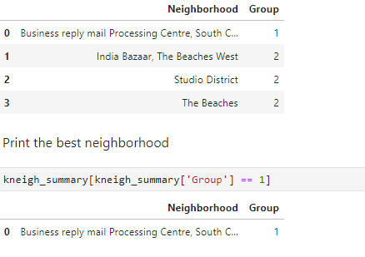
Decision making
THE BEST NEIGHBORHOOD
Business reply mail Processing Centre, South Central Letter Processing Plant Toronto'

Slide 13


